Slide 1
/BIOSTATS 4
/ SUMMER RESEARCH
JSMBS_CRASH
Coding with Real Applications for Students in Healthcare

Slide 2

JSMBS_CRASH

Slide 3
/Choosing a Test
JSMBS_CRASH

Slide 4

JSMBS_CRASH
Three criteria are decisive for the selection of the statistical test, which are as follows:
the number of variables,
types of data/level of measurement (continuous, binary, categorical) and
the type of study design (paired or unpaired).

Slide 5
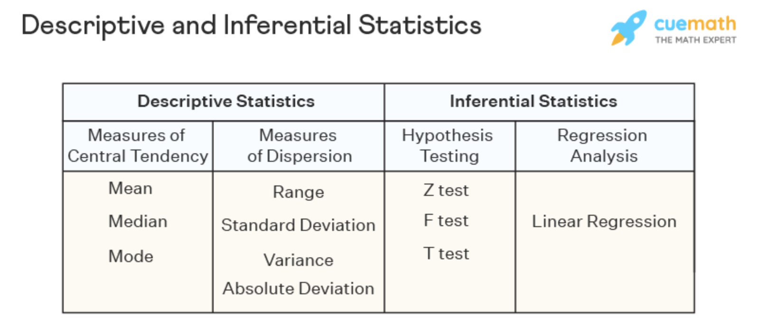
/Number of Variables
JSMBS_CRASH
Single Variables = Descriptive Statistics
Mean , median , standard deviation , boxplot etc
>1 Variables = Relationships
Most of the “tests” ie t–Test, Chi Squared, Rank Sum Test

Slide 6
/Level of Measurement
JSMBS_CRASH
Continuous
Can take any value within a certain range (infinite values between 0 and 1!)
ex BP can be 120.1 , 101.7 etc mmHg
Each individual number therefore has zero probability, we can only assign probability to ranges of values ie (P (BP < 115)
Binary
Yes or No
Ex “Is BP > 125”
Each level (Y/N) has a distinct probability
Categorical
Can take only enumerated values
Ex BP is [“High”, “Low”, “Normal”]
Each level has a distinct probability

Slide 7
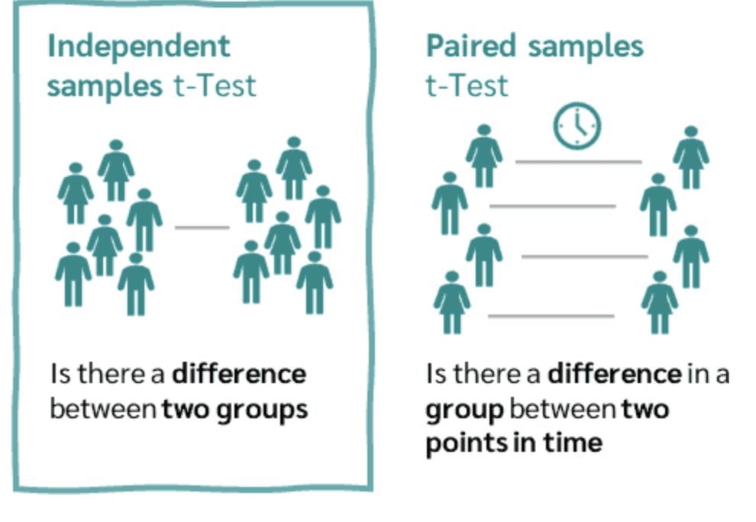
/Type of Study Design
JSMBS_CRASH
Paired = Dependent
results can be obtained for each patient under all experimental conditions
Ex- Measure ONE person’s heart rate before and after running a marathon
Ex- Measure ONE person’s eczema levels on Drug A and on Drug B (each on different arms)
Unpaired = Independent
results for each patient are only available under a single set of conditions
Ex
Group A all take drug A (only)
Group B all take drug B (only)
We then measure the difference between GROUPS

Slide 8
These 3 things are all you need to know to choose statistical tests!
JSMBS_CRASH

Slide 9
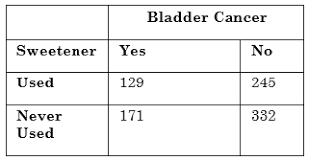
You want to study Sweetener’s Effect on Bladder Cancer
JSMBS_CRASH
the number of variables = 2,
types of data/level of measurement
Sweetener = Categorical
Cancer = Binary
the type of study design
Unpaired

Slide 10
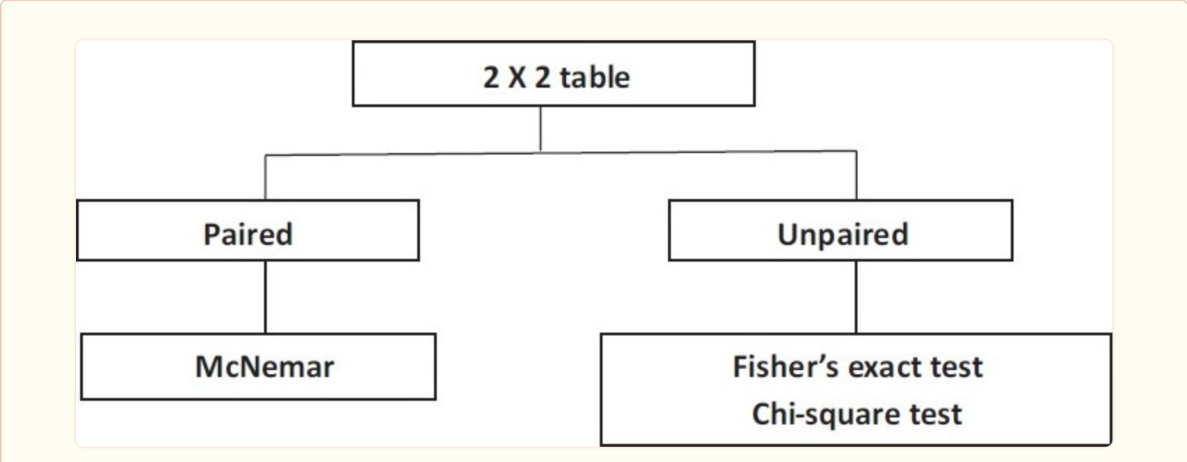
JSMBS_CRASH
Notes:
group comparison with two categorical endpoints.

Slide 11
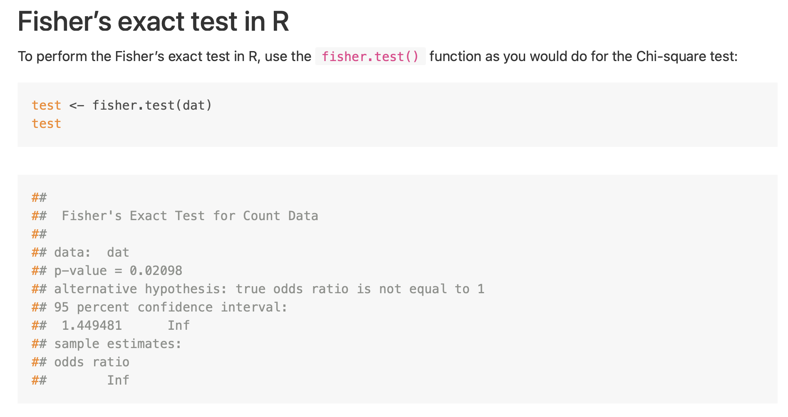
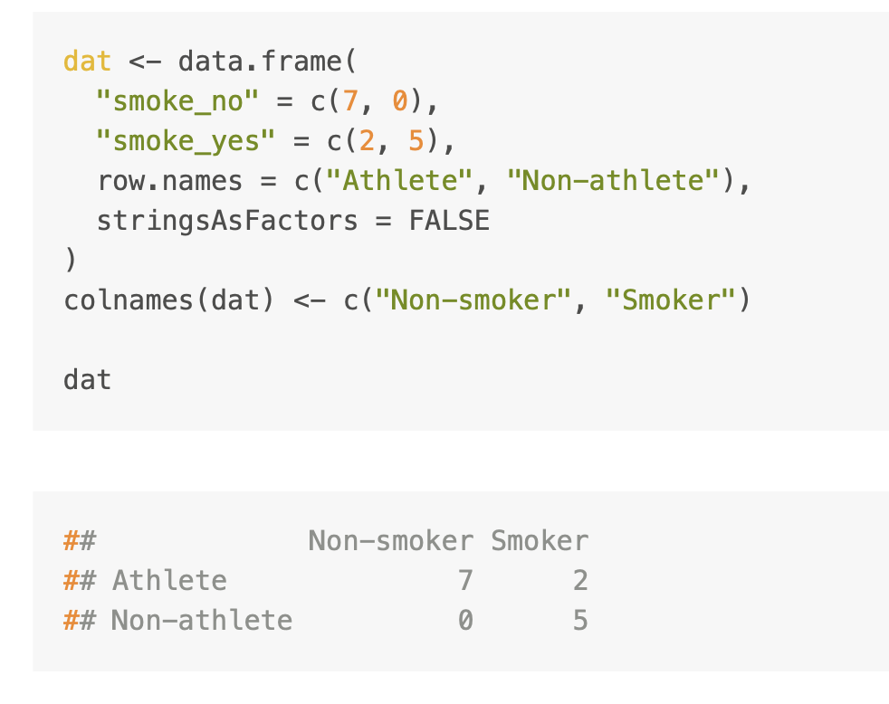
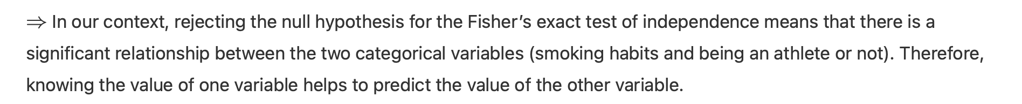
Fishers’s Exact Test
JSMBS_CRASH

Slide 12
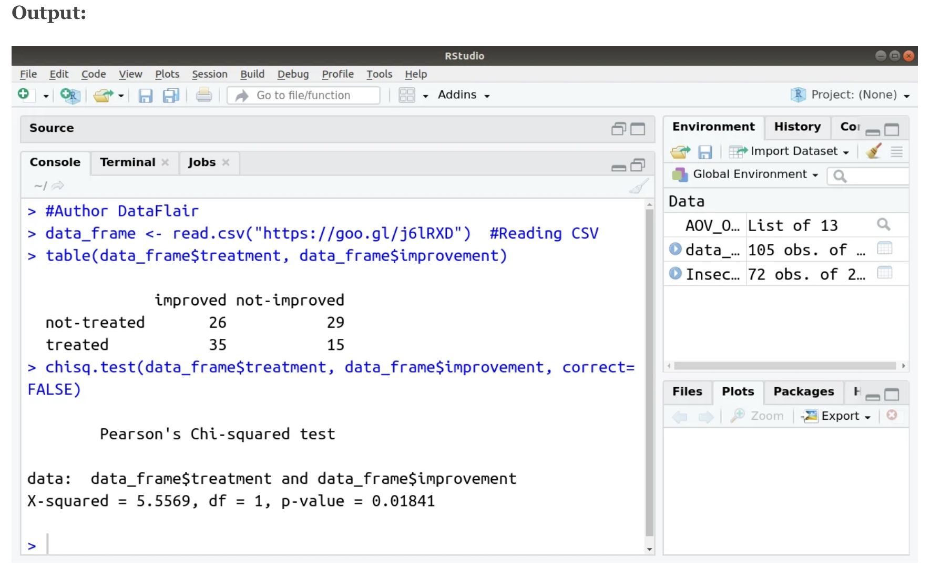
Chi Square Test
JSMBS_CRASH

Slide 13
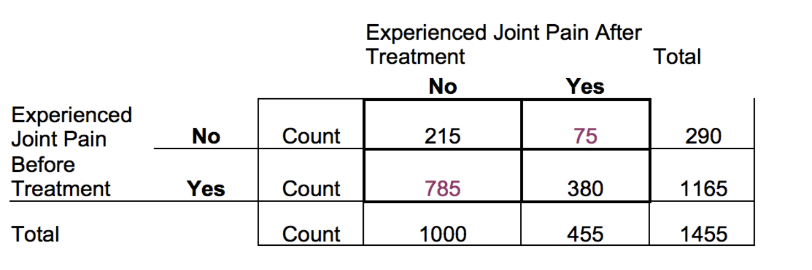
You want to study joint pain before and after treatment
JSMBS_CRASH
the number of variables = 2,
types of data/level of measurement
Before = Binary
After = Binary
the type of study design
Paired

Slide 14
JSMBS_CRASH
Notes:
group comparison with two categorical endpoints.

Slide 15
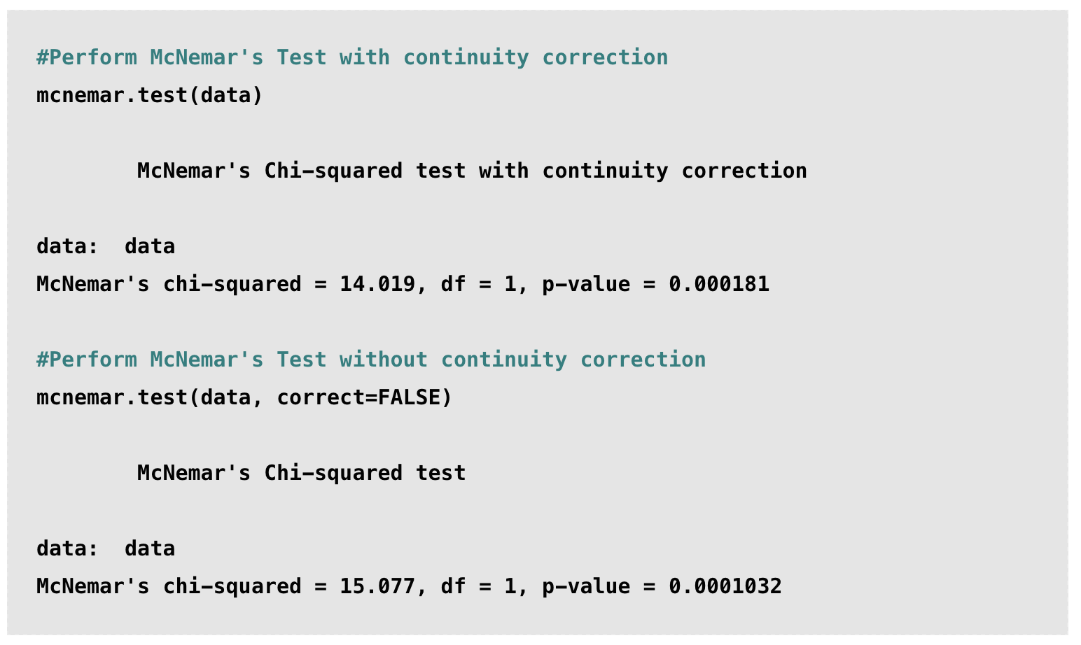
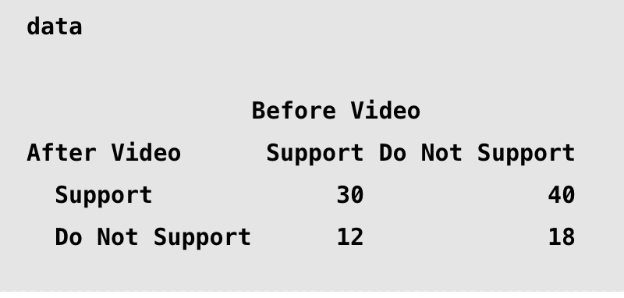
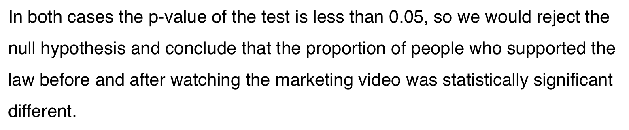
McNemar Test
JSMBS_CRASH

Slide 16
A Note on Packages
JSMBS_CRASH
Packages are collections of modules (AKA libraries) that organize code and make it easier to use
Typically contain pre-written functions, classes, and variables
A very important one for R is dplyr, which is a grammar framework for data manipulation
Contains the statistical tests with the syntax previously shown, plus others
If dplyr is is not already installed, it can be with the install.packages( ) command and loaded in normal fashion with library( )

Slide 17
/Continuous Data
JSMBS_CRASH

Slide 18
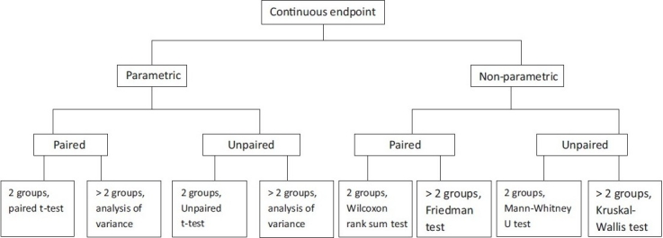
JSMBS_CRASH

Slide 19

JSMBS_CRASH

Slide 20
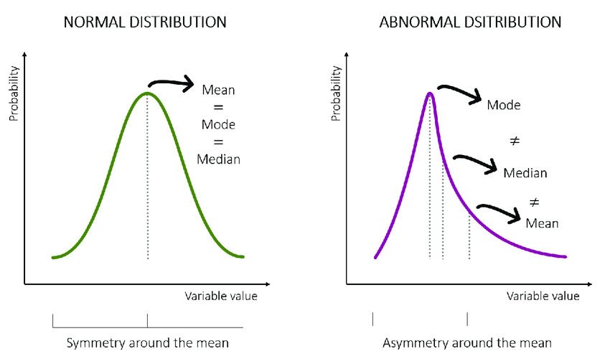
/Okay we lied on more thing
JSMBS_CRASH
Parametric
Endpoint is normally distributed
Non- Parametric
Endpoint is not normally distributed
How can I tell?
Shapiro Wilk Test or Kolmogorov Test

Slide 21

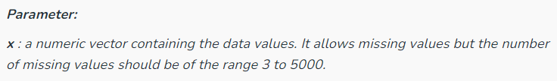
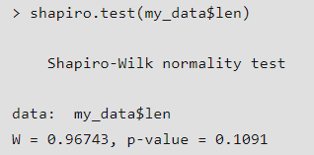
Shapiro Wilk Test
JSMBS_CRASH
Null hypothesis is that data is normally distributed
p < 0.05 suggests significant difference, reject null (i.e., data is not normally distributed)
p > 0.05 suggests no significant difference, accept null

Slide 22
JSMBS_CRASH

Slide 23
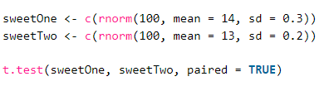
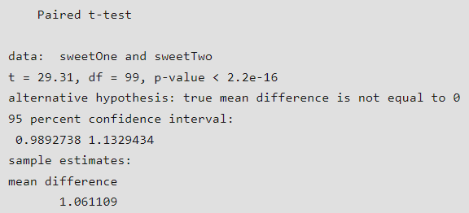
Paired T Test
JSMBS_CRASH
Data comes from measurements of an identical group/set of observations made under two different conditions (ex. different time)
Null hypothesis is that the difference between the means is not noticeably different from zero
p < 0.05 means there is a significant difference
p > 0.05 means there is not a significant difference

Slide 24
JSMBS_CRASH

Slide 25

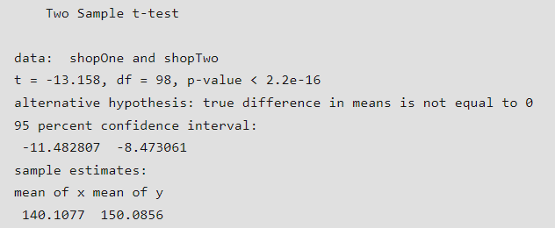
Unpaired T Test
JSMBS_CRASH
Null hypothesis is that there is no significant difference between the means of the sample populations
Note: var.equal = TRUE is a flag to prevent R from running Welch’s test, since R assumes variances are unequal if not specified.

Slide 26
JSMBS_CRASH

Slide 27
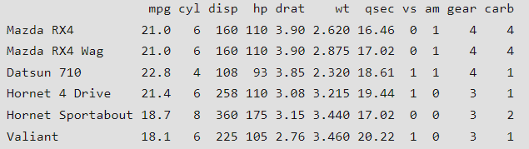

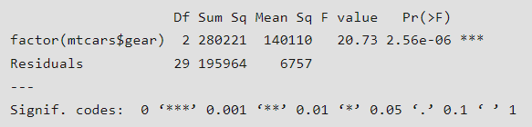
ANOVA (One-way)
JSMBS_CRASH
← data set
Null hypothesis is that means of all categories are the same
aov function does test and assigns results to a variable
In this example, mean of “gears” category is significantly different

Slide 28
JSMBS_CRASH

Slide 29
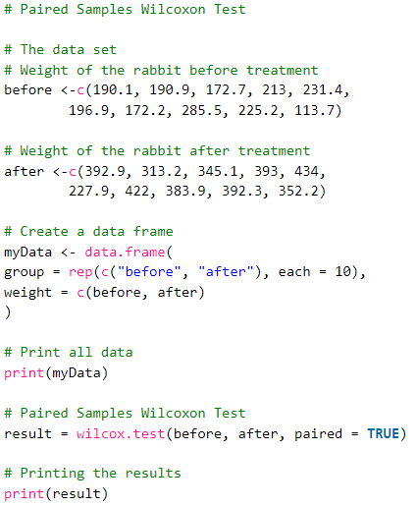
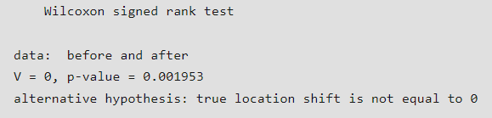
Rank Sum Test
JSMBS_CRASH
Null hypothesis is that median weights of population are not significantly different between observations
Since p < 0.05 in the example, we reject the null

Slide 30
JSMBS_CRASH

Slide 31
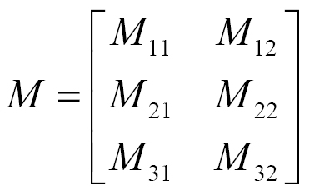
A Note on Linear Algebra (Scary!)
JSMBS_CRASH
When coding, you will frequently see the terms vector and matrix used in (potentially) unfamiliar contexts. Understanding what is meant by is often important for proper syntax.
Scalars are single numbers
Ex. 5.5 is a scalar quantity
Vectors are lists of numbers arranged along an axis
Ex. v = {1, 2, 3, 4} is a vector
All of the previous example data sets were entered into R as vectors
Matrices are numbers arranged along two axes
Ex.
The above are 0th, 1st, and 2nd order tensors, respectively. Tensors are generalizations of the above. You are unlikely to encounter higher order tensors, but may find the term used in specific applications.

Slide 32
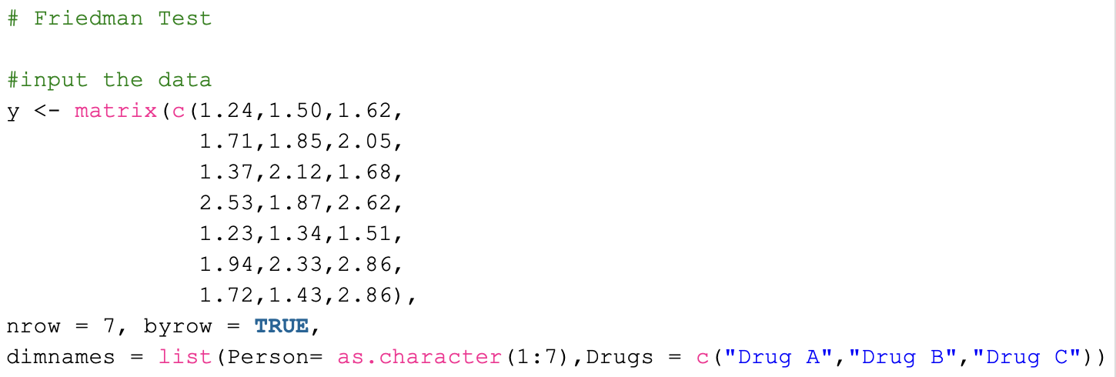

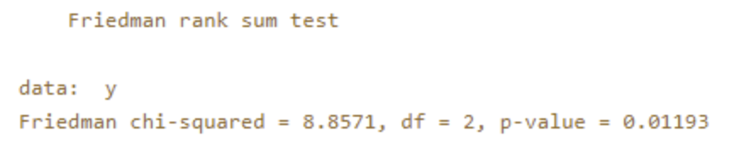
Friedman Test
JSMBS_CRASH
Null hypothesis is that all three groups (drugs) have the same probability distribution

Slide 33
JSMBS_CRASH

Slide 34
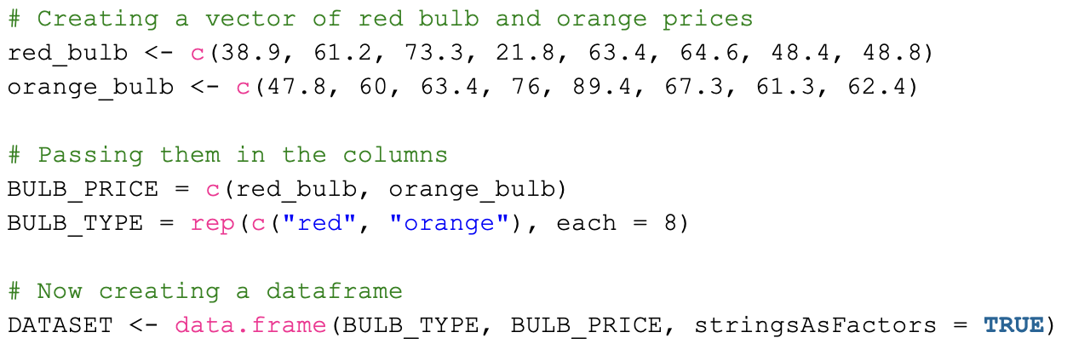
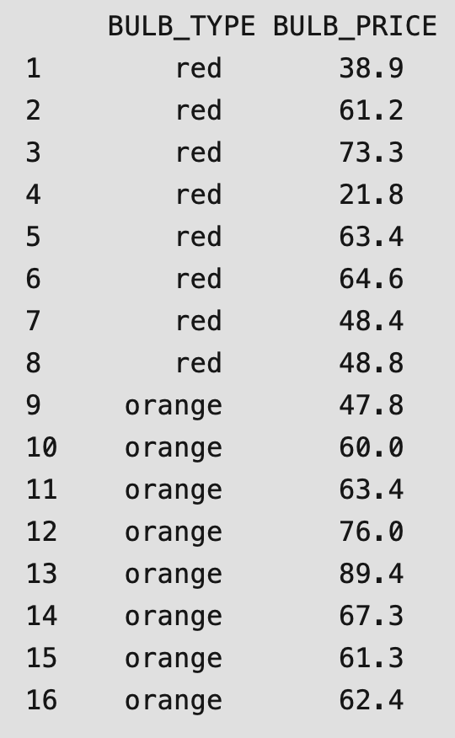
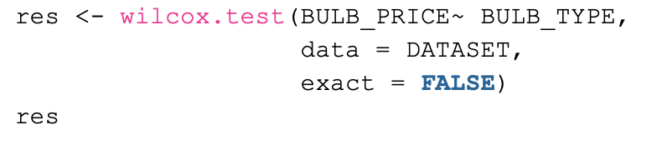
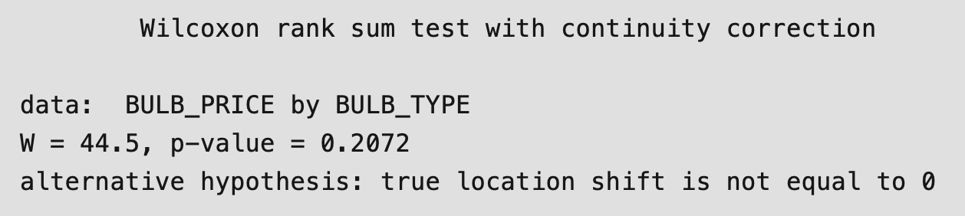
Mann-Whitney test
JSMBS_CRASH
Null hypothesis is that the two ordinal categories have the same distribution
Box plot is particularly helpful here for visualization of distributions, requires separate packages to generate

Slide 35
JSMBS_CRASH

Slide 36
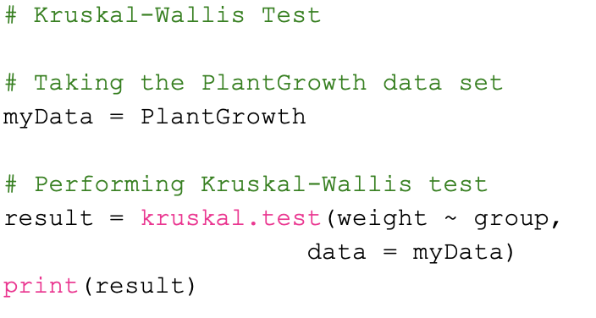
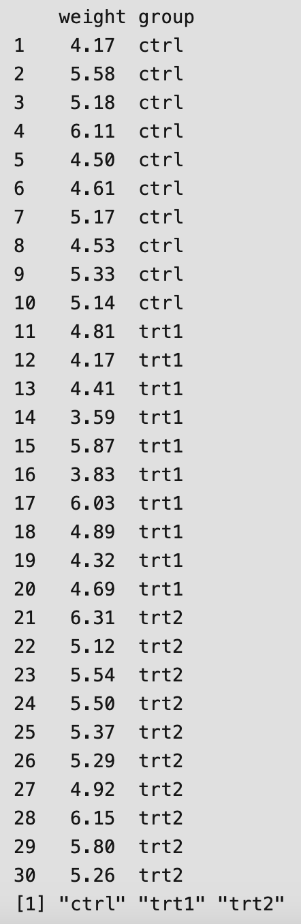
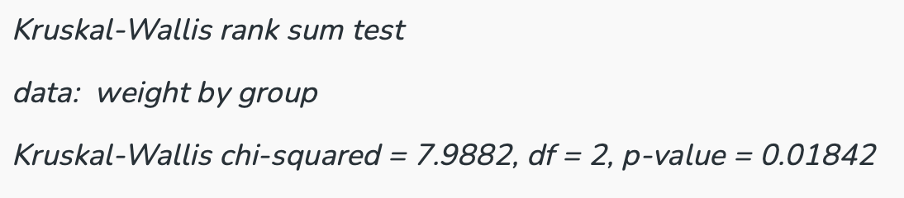
Kruskal-Wallis Test
JSMBS_CRASH
Null hypothesis is that there are no significant differences between the distributions of all groups
Note: does not specify which group differs - best determined visually via box plot

Slide 37
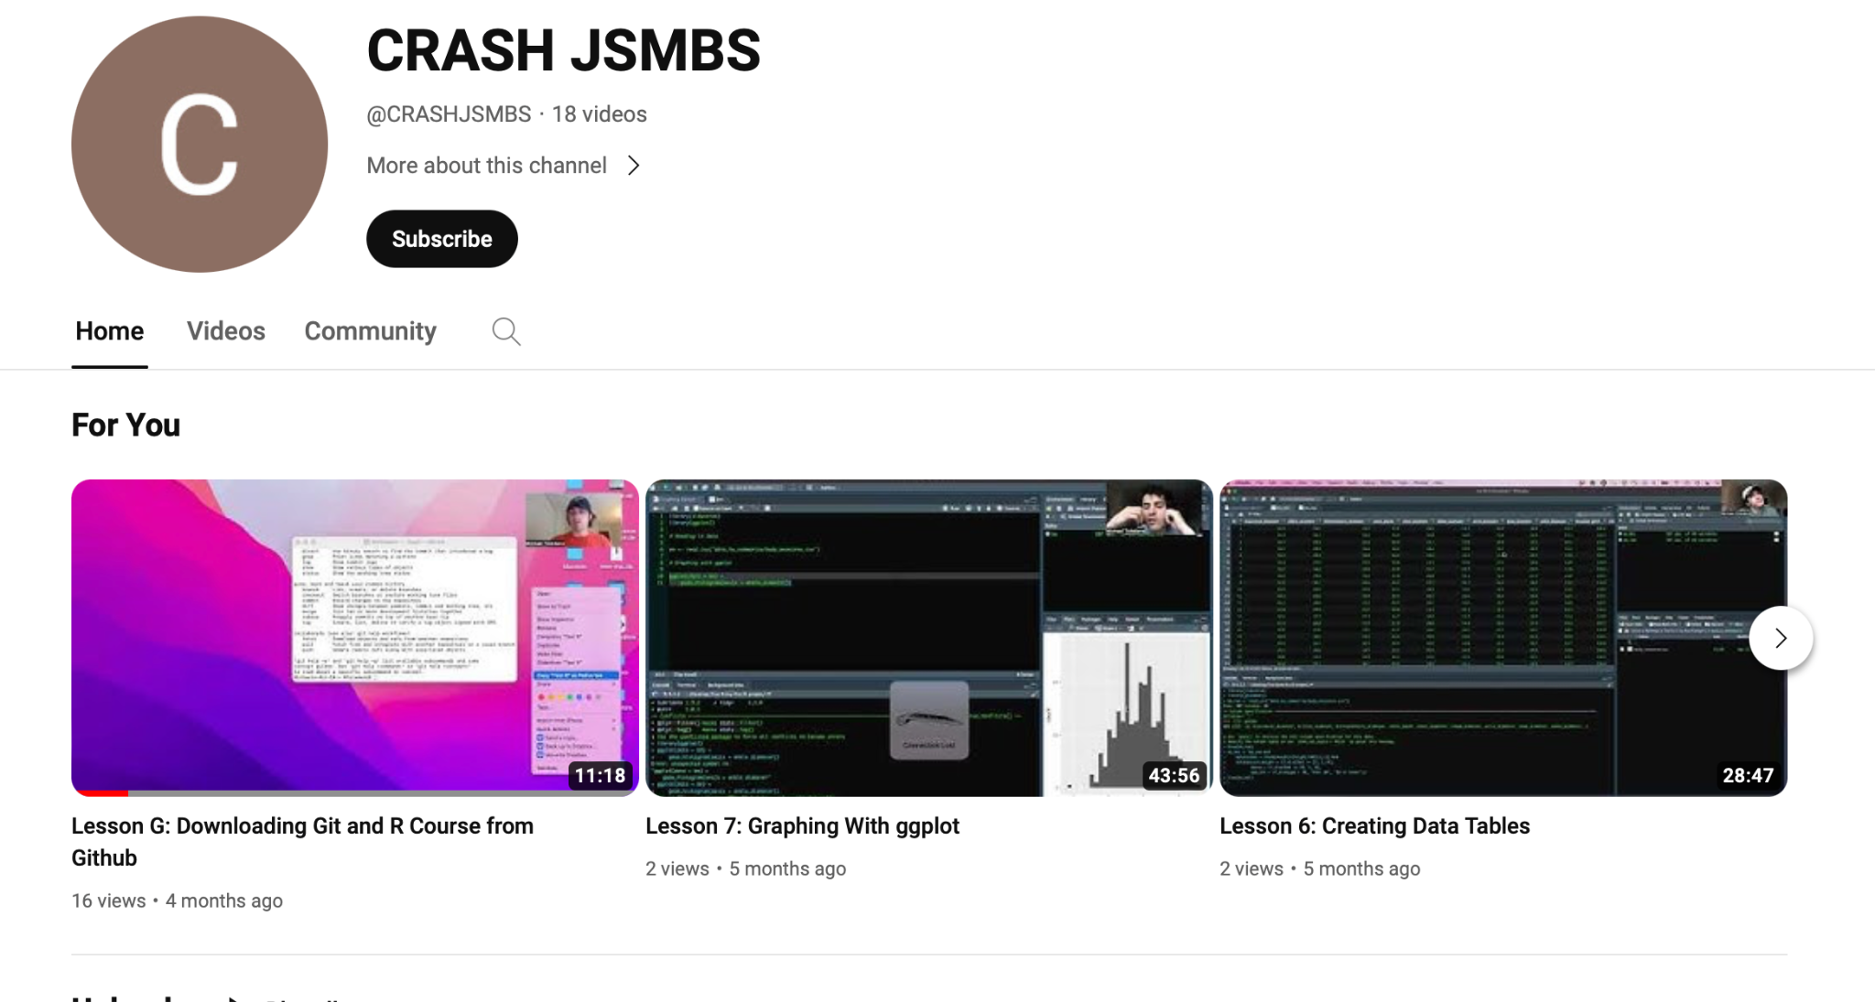
/How do I run tests?
JSMBS_CRASH
Luckily a member of previous Eboard, Mikey Toledano, and our current pres Anneliese Markus made an entire course on how to conduct data analysis in R, including youtube videos!
And we will be hosting further sessions on coding for data analysis and figure generation
https://github.com/jsmbsCRASH/CRASH_R

Slide 38
if(Question == TRUE) {print(“I don’t know!”)}
JSMBS_CRASH

